Slide 1
Toxic CommeNt classifier
Using NLP

Slide 2

Introduction
Toxic comment classification is a vital application of Natural Language Processing (NLP) aimed at identifying and categorizing offensive, harmful, or abusive comments posted on various online platforms.
These platforms include social media, discussion forums, news websites, and more.

Slide 3
PROBLEM Statement
The goal is to create a classifier model that can predict if input text is inappropriate (toxic)
Clean comment:- The comment which is normal and doesn’t create any disturbance in one’s environment .
Toxic comment:- A toxic comment is defined as a rude, dis- respectful, or unreasonable comment that is likely to make other users leave a discussion.
Aim is to know about the percentage of each comment in the dataset.

Slide 4
Use of NLP in the Toxic comment classification
Natural Language Processing (NLP) plays a crucial role in toxic comment classification, enabling the identification and categorization of harmful or inappropriate content in online platforms. Here's how NLP is utilized in toxic comment classification:-
Text Preprocessing
Feature extraction
Word Embeddings
Text classification models
Training and classifier
Sentiment analysis ,etc..

Slide 5
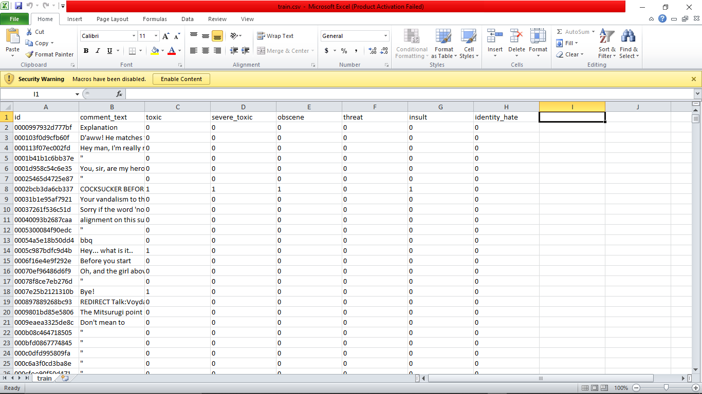
Dataset

Slide 6
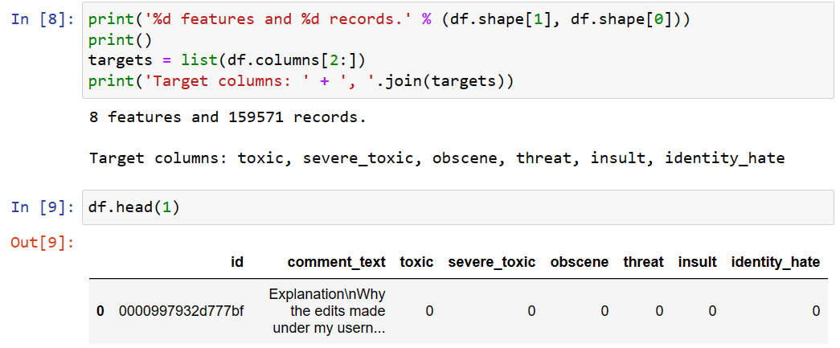
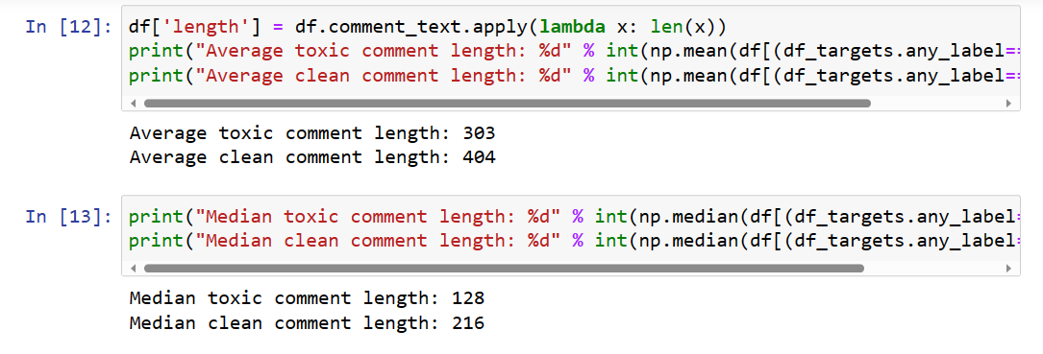
Data Preprocessing

Slide 7
Algorithms and Technologies
Logistic Regression (Benchmark)
Multinomial Naive Bayes
Support Vector Machine
Support Vector Machine with Naive Bayes Features
All these are supervised learning techniques which is processed with the labeled data.

Slide 8

Uses of Toxic comment classifier
Filtering and Blocking
Comment section cleanup
Protecting content creators
Sentiment analysis and feedback
Customization for different platforms
Ad campaign safety
Crisis management

Slide 9
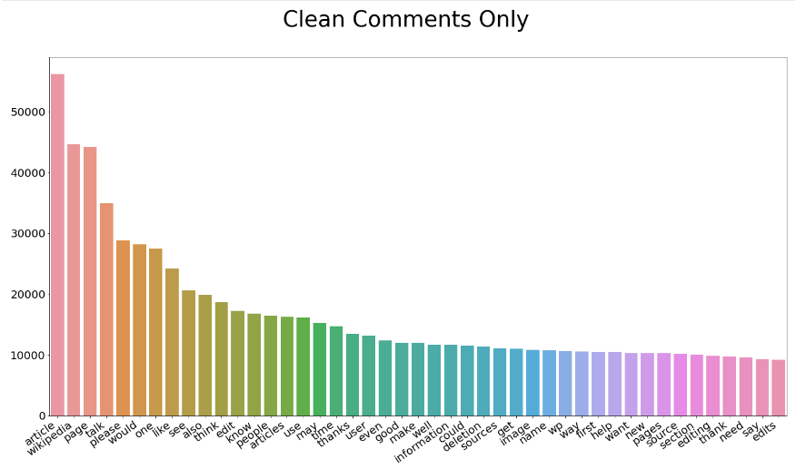
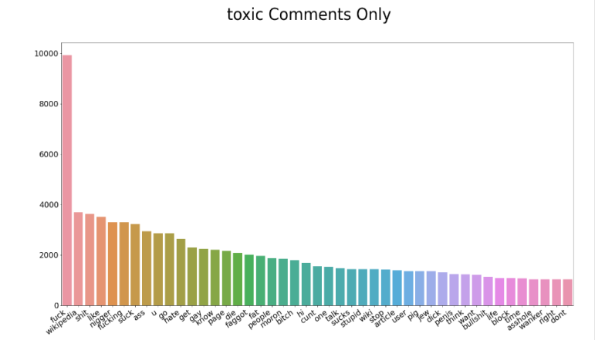
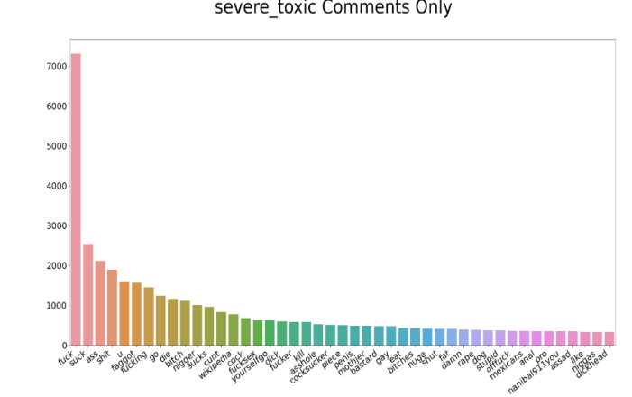
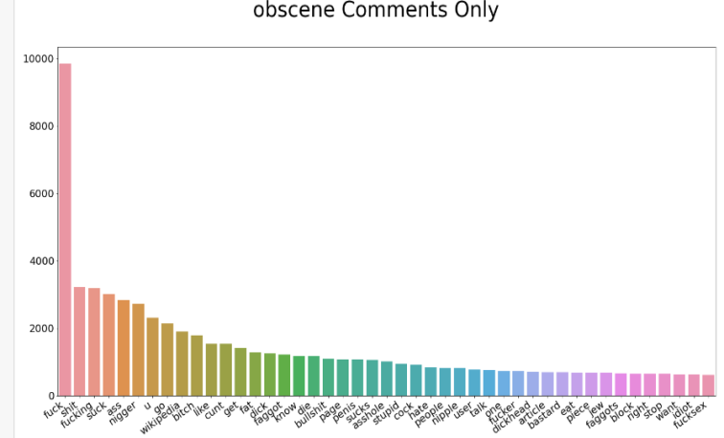
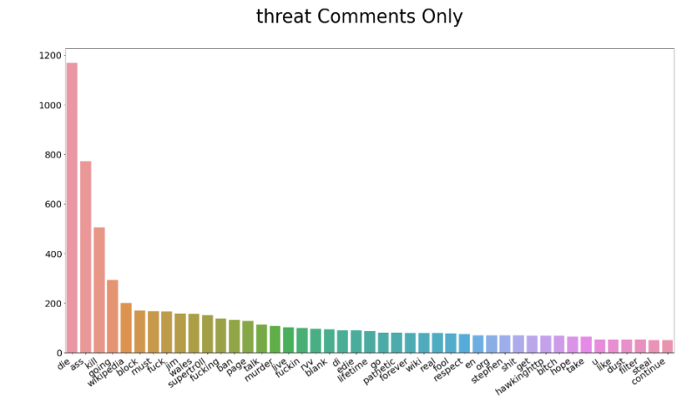
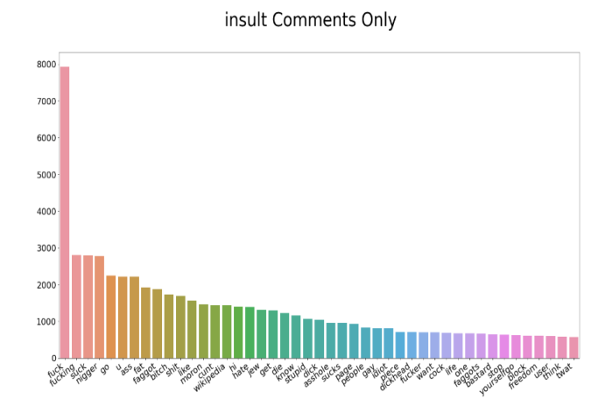
Conclusion

Slide 10


